Slide 1




Home
About
Contact
AYU.AI
India’s First Truly Smart Healthcare App
POWERED BY SARVAM.AI

Slide 2
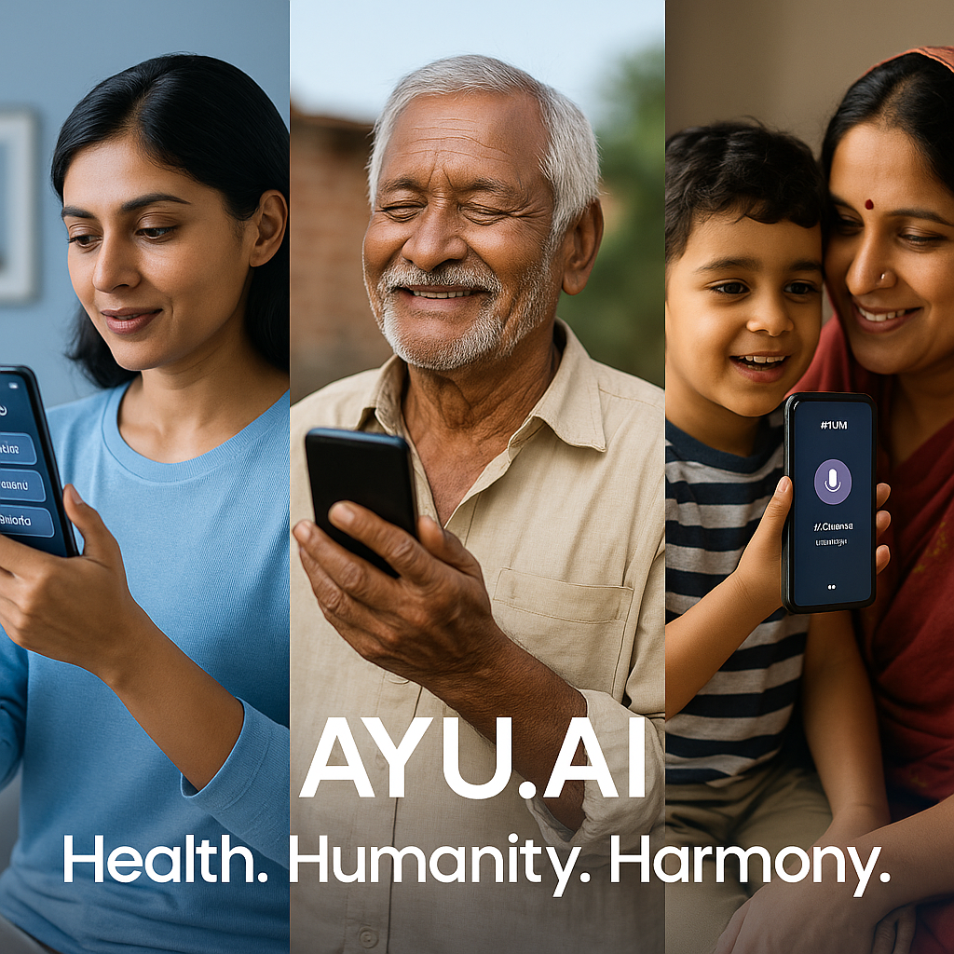
Home
About
Contact
Overview
I didn’t build AYU.AI as just another app. I built it because I’ve lived the helplessness — when my own Nana ji went through a long struggle just because we couldn’t detect his illness in time. That one regret still burns quietly in the background of everything I do.
AYU.AI is born from that very pain — and a promise to never let anyone feel that helpless again.
This app is for every Indian, not just the tech-savvy. From a child in a school hostel, to an old dadi sitting in a rural village without access to top hospitals — everyone deserves clarity, care, and comfort.
And not just in English or Hindi — AYU understands the way we really talk. That mix of regional + Hindi + English… that is real India. And AYU gets it. Whether you type it, say it, or upload it — AYU listens.
But it doesn’t stop there.
From predicting what might be wrong… to giving affordable, homemade solutions… to even telling you what to eat if you can’t afford apples and almonds.
AYU is not some bot.
It’s your true health companion, built with care, not code.
No ads. No unnecessary drama. No distractions.
Just you, your health, and a friend who’s always there.
Whether you're online, offline, scared, unsure
AYU doesn’t leave your side. Ever.
"Because health shouldn’t be a privilege. It should be a promise."

Slide 3
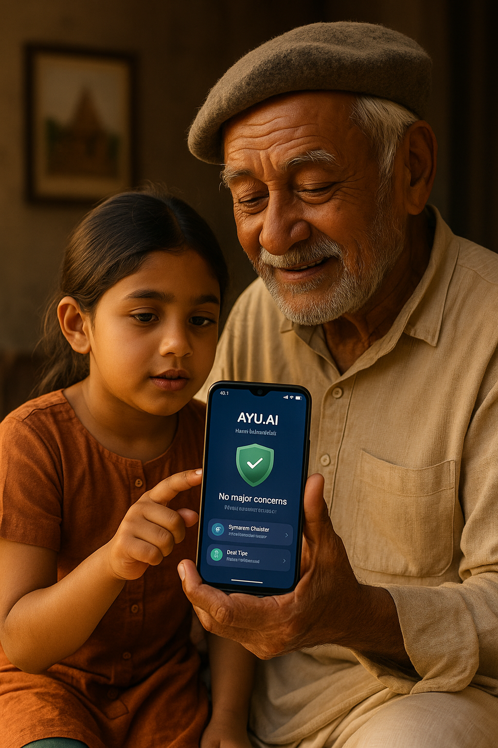
Home
About
Contact
About the Application
AYU.AI isn’t just an app — it’s a deeply personal mission turned into reality.
It’s a healthcare companion designed for every Indian, built to guide, support, and protect — not just with information, but with understanding.
At its core, AYU.AI blends AI technology with human empathy. Whether someone is from a big city or a remote village, whether they speak fluent English or mix Hindi with their local dialect, AYU.AI speaks their language — literally.
It starts with a simple question: “What’s wrong?” And from there, it listens, analyzes symptoms, and predicts possibilities using AYU Predict — a smart, AI-based diagnosis tool that gives percentage-wise predictions for likely health issues, so you don’t stay in the dark anymore.
Need to talk? Just tap AYU Sense — your emotionally aware assistant.
You can type, speak, or even upload a photo or doctor’s prescription — AYU understands it all and responds in a natural, reassuring way, like someone who genuinely cares.
From daily parhej/diet tips, home remedies, and verified video suggestions, to an active community space where people share experiences, and a built-in Emergency SOS mode that works even without internet.
AYU is designed to be there when it truly matters.
Every screen, every feature, every word has been crafted to feel simple, fast, fluid, and human.
No distractions, no ads, no confusion. Just honest help.
This app doesn’t replace doctors. It helps people reach them sooner, understand themselves better, and save precious time, money, and lives.
AYU.AI is made with heart, for your health — and for the millions who still don’t have someone to ask “How are you feeling today?”

Slide 4

Home
About
Contact
AYU Predict :
Your body speaks. AYU listens. Just describe what you’re feeling — headache, weakness, fever, anything — and AYU Predict uses advanced AI to give you a percentage-wise prediction of possible health issues. It doesn’t replace a doctor, but it helps you understand what’s happening — and what your next step should be. Smart health awareness, before it’s too late.
Services
AYU Sense :
Not a chatbot. Not a script. A true listener. AYU Sense is your multilingual, emotionally aware assistant that understands how we really speak — a mix of Hindi, English, and local languages. You can type, talk, or upload prescriptions/images. AYU responds with clarity and compassion. It’s like talking to someone who truly gets you.
Diet-&-Parhej :
Because health isn’t just medicine — it’s also what you eat. AYU gives you regionally practical, affordable diet tips, including what to eat, what to avoid, and even home remedies. Whether you can afford dry fruits or just have daliya and khichdi — AYU shows you a way. Real-world advice for real people.

Slide 5

Home
About
Contact
Vision
Healthcare That Feels Human :
Equal Access , Real Reach :
AI With Code Not Just Code :
We don’t just want to build an app — we want to build trust. AYU.AI is here to make healthcare feel like a conversation, not a complication. Whether it’s a child, a farmer, or a senior citizen — the app should feel like their own.
From metro cities to the last village, AYU.AI aims to break the barrier of language, tech, and cost. Even with low-end phones or slow internet, people should still get accurate, verified health guidance in their comfort language and comfort level.
AI is everywhere — but AYU.AI is built with balance. Not too much, not too little. Just the right amount of tech blended with real empathy and Indian values. We believe in using AI the way we use salt in food — swad anusar, not just for show.

Slide 6
Home
About
Contact
Mission
To Save Lives , Money & Lives :
To Build A Health Companion :
In India, people often reach hospitals too late or spend lakhs on wrong treatments due to confusion. AYU.AI wants to be the first step toward clarity — saving time, effort, and lives through early prediction and smart guidance.
This is not a medical directory. It’s a humanized experience. AYU.AI aims to become that one trusted friend people turn to — especially in fear, doubt, or emergency. Always present. Always helpful..
To Empower , Not Overwhelm :
To Make Bharat Truly Healthy :
Most health apps throw information. AYU.AI simplifies it — giving only what’s needed, when needed, in the way you best understand. Less clutter, more care.
India deserves health tech that reaches beyond cities — in language, speed, affordability, and emotion. AYU.AI is built with Bharat in mind, to ensure no one is left behind in the race for better health.

Slide 7
🧩 Core Components:
AYU Predict – Symptom-based AI prediction with actionable output
AYU Sense – Chat + Voice + Upload AI Assistant with deep empathy
Diet & Parhej – Regionally smart, budget-friendly food & lifestyle guidance
Emergency SOS – Offline-ready instant help
Community – Peer advice, verified tips, real experiences
Reports & Family Health – Track and support across generations
Multilingual Support – Hindi, English, and regional languages
🌍 Scope of Impact:
India-first, Global-ready
Urban + Rural healthcare reach
AI-enabled for hybrid language understanding
Built for all age groups, devices, and literacy levels
🧠 Project Type:
AI-based Mobile Application (Healthcare | Civic Tech | Human-centric Design)
Portfolio
Home
About
Contact
📁 Project Name: AYU.AI – Your Personal Health Saathi :
An emotionally intelligent, AI-powered multilingual health assistant app that aims to bridge the healthcare gap in India by providing accessible, intuitive, and reliable health support to every citizen — urban or rural, young or old.
🧠 Project Type:
AI-based Mobile Application (Healthcare | Civic Tech | Human-centric Design)
🌍 Scope of Impact:
India-first, Global-ready
Urban + Rural healthcare reach
AI-enabled for hybrid language understanding
Built for all age groups, devices, and literacy levels
🚀 Future Scope :
IVP Helpline Calls 📞
WhatsApp AYU Chatbot 💬
2G/3G Low-Data Mode 📶
Offline Info Packs 📨
Health Device Integration (Wearables) ⌚
Rural-First Voice Access 🔈
🧩 Core Components:
AYU Predict – Symptom-based AI prediction with actionable output
AYU Sense – Chat + Voice + Upload AI Assistant with deep empathy
Diet & Parhej – Regionally smart, budget-friendly food & lifestyle guidance
Emergency SOS – Offline-ready instant help
Community – Peer advice, verified tips, real experiences
Learn Health – Gain knowledge from trusted sources
Reports & Family Health – Track and support across generations
Multilingual Support – Hindi, English, and regional languages

Slide 8
🧩 Core Components:
AYU Predict – Symptom-based AI prediction with actionable output
AYU Sense – Chat + Voice + Upload AI Assistant with deep empathy
Diet & Parhej – Regionally smart, budget-friendly food & lifestyle guidance
Emergency SOS – Offline-ready instant help
Community – Peer advice, verified tips, real experiences
Reports & Family Health – Track and support across generations
Multilingual Support – Hindi, English, and regional languages
🌍 Scope of Impact:
India-first, Global-ready
Urban + Rural healthcare reach
AI-enabled for hybrid language understanding
Built for all age groups, devices, and literacy levels
🧠 Project Type:
AI-based Mobile Application (Healthcare | Civic Tech | Human-centric Design)
Portfolio
Home
About
Contact
🌐 Sarvam AI Integration – A Proud Leap Towards Atmanirbhar Bharat
In our continuous effort to make AYU.AI deeply Indian at its soul and truly global in its impact, we envision integrating Sarvam AI — India’s very own open-source LLM (Large Language Model), crafted for our people, in our languages, with our values.
Unlike imported AI systems, Sarvam AI understands Bharat’s soul, from dialects to daily struggles. Its inclusion in AYU.AI ensures:
💬 Truly Indian Multilingual Support – Rooted in regional fluency
🤝 Data Privacy with Local Hosting – No overseas exposure
🪔 Spiritual + Cultural Awareness – Built on India-first values
🧠 Low-resource Optimization – Made for devices with limited power & low data usage
Together, AYU.AI x Sarvam AI doesn’t just represent a health-tech tool — it represents India’s voice, intellect, and emotion wrapped into one powerful, compassionate health companion.
“It’s not just technology. It’s our identity.”

Slide 9

Home
About Us
Contact
Contact Me
+918770051580
prathvirajsinghsushma@gmail.com

Slide 10

Thank You

